Slide 1

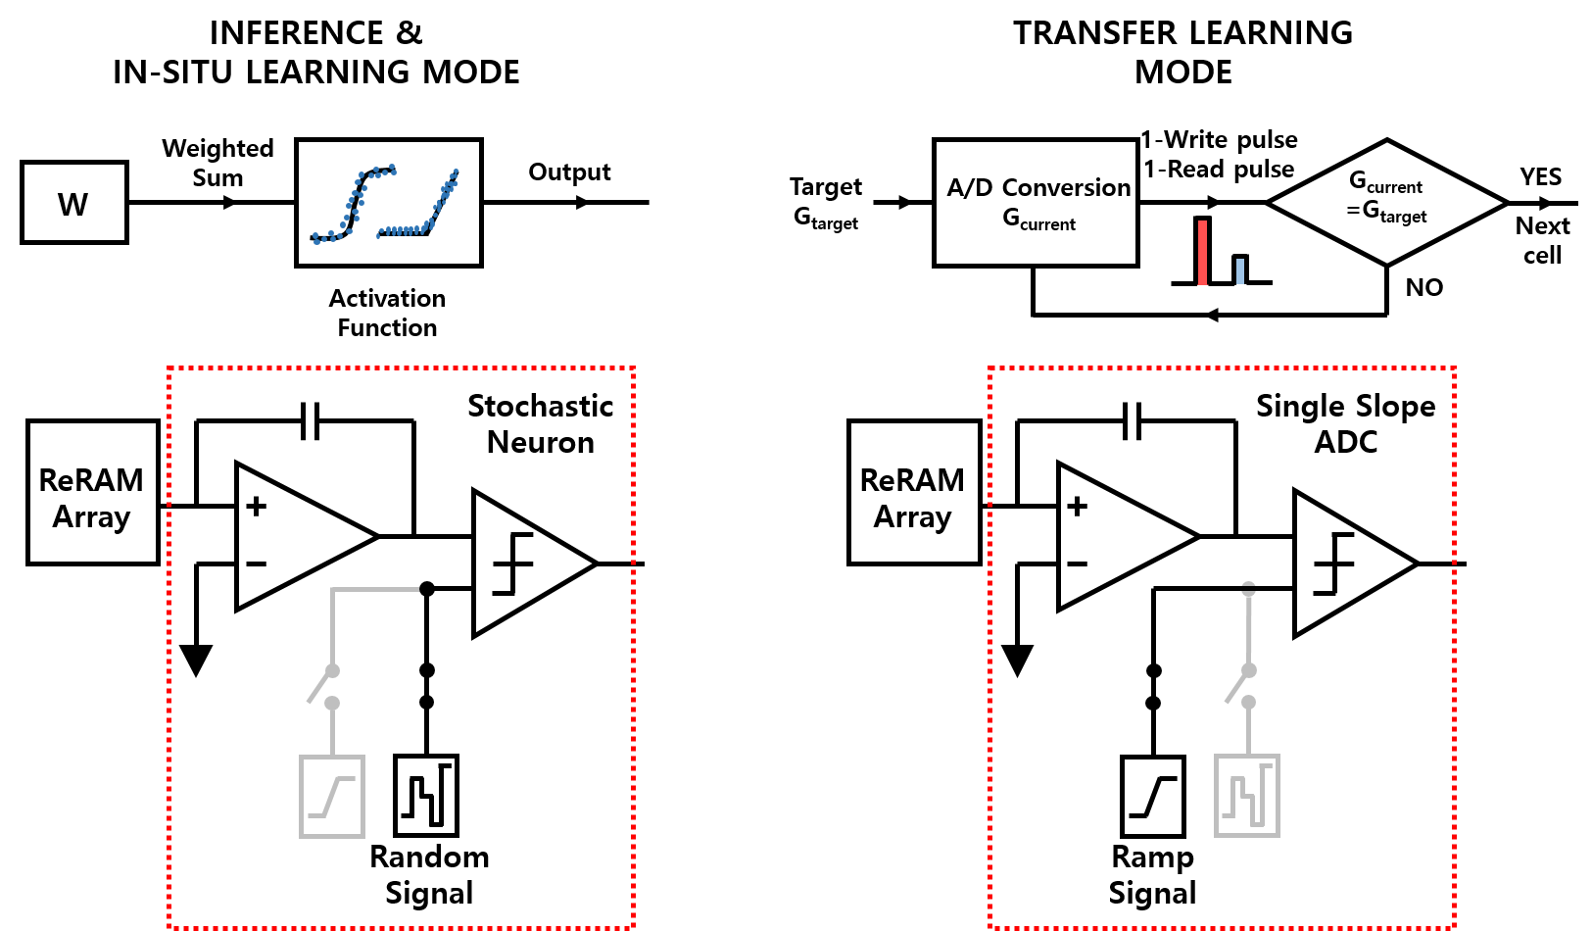
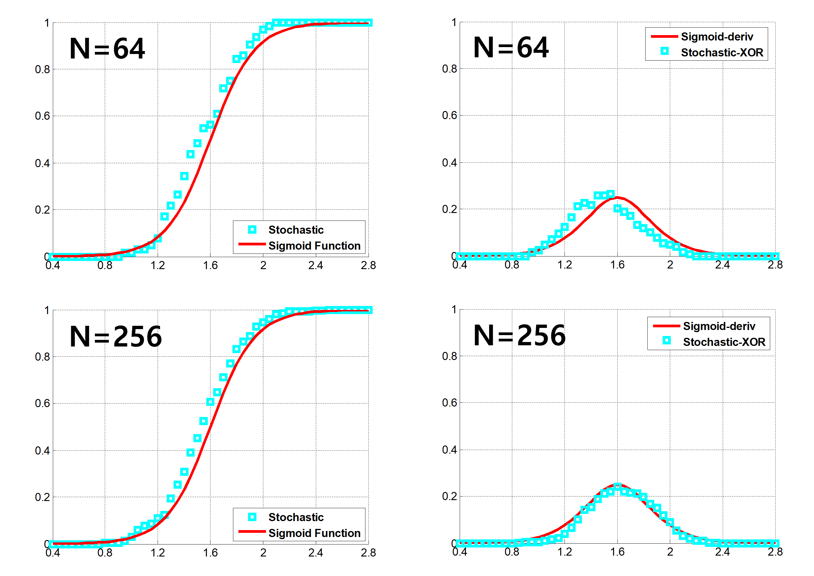
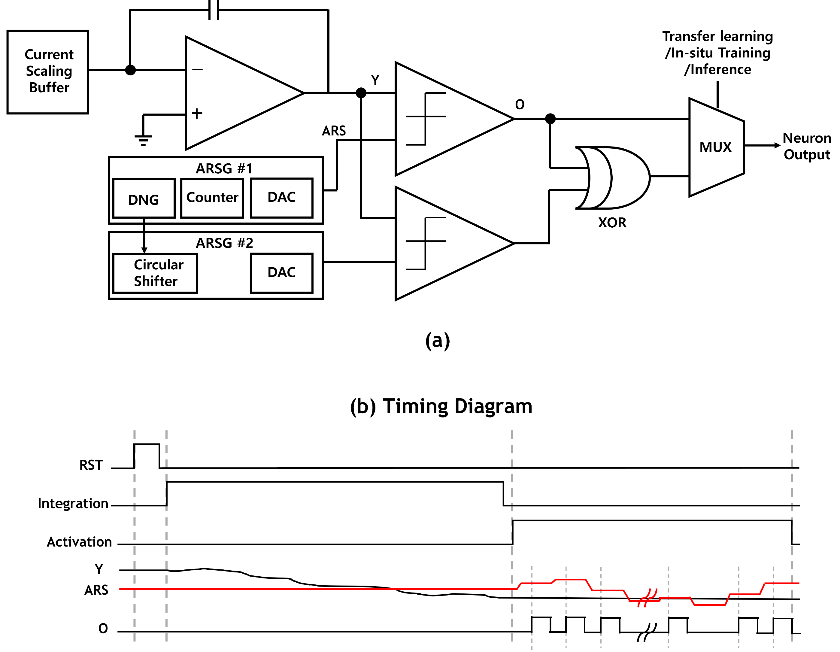
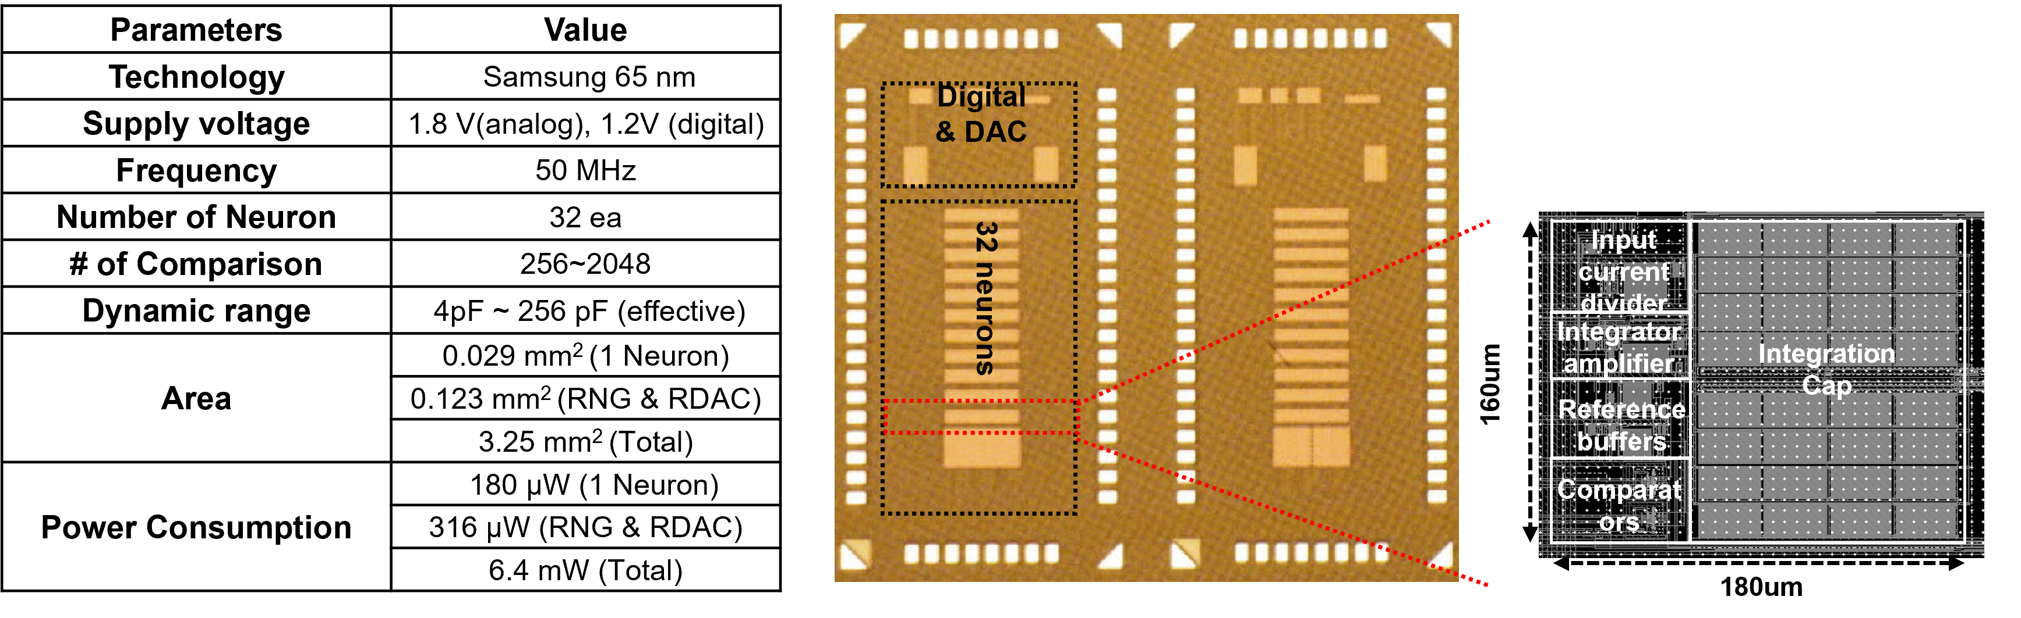
Hybrid Stochastic Neuron circuit for inference and training
Sang-Gyun Gi, Dowon kim, Sunghoon cho and Byung-Geun Lee
Gwangju Institute of Science and Technology, y2ksk2@gist.ac.kr
INTRODUCTION
B. Learning with HSN
HSN is used to implement both in-situ training and transfer learning. When operating for in situ learning, the HSN works as the stochastic neuron that produces the stochastic activation function. On the other hand, when operating of transfer learning, the HSN works as the SS ADC using analog ramp signal instead of ARS, as shown in Fig. 2.
Fig.2 In situ training and transfer learning with HSN
Recently neuromorphic hardware has received significant attention as a new hardware architecture beyond the von Neumann’s computing system. Especially, memrsitor device is two-terminal and specialized for crossbar array, which produces high density and extreme low power to perform many multiply-summation in parallel in voltage/current domain. In previous work, the stochastic neuron (SN) is suggested to overcome the power and area efficiency of the neuromorphic hardware. However, the SN has a precision issue that a number of comparisons are required for increasing the precision of the SN. Besides the precision issue not only decrease the total throughput of the SN but also is limited to the transfer learning. The proposed HSN can mitigate the precision issue by using single-slope analog-to-digital converter (SS ADC) mode. In addition, the HSN can produce the derivative function of sigmoid, which is a key function for the back-propagation algorithm, as well as the activation function including sigmoid and ReLU.
SYSTEM ARCHITECTURE
A. Hybrid Stochastic Neuron
Fig. 1(a) shows hybrid stochastic neuron (HSN) which is designed to implement the mathematical model of neuron by a circuit, which contains current integrator and activation function. The continuous RC integrator is designed by switched capacitor circuit and integrates the current from the memristor. The activation function is implemented by using the stochastic characteristics of analog random signal (ARS). The timing diagram of HSN is shown in Fig. 1(b).
Fig. 1 (a) Schematic of HSN (b) Timing diagram of HSN
The HSN has two sets of analog random signal generators (ARSG) and the comparators to produce the derivative of sigmoid function, which is a key function for the back-propagation algorithm. The HSN makes possible for the weight update computation of back-propagation algorithm to be implemented on a hardware.
MEASUREMENT RESULTS AND SPECIFICATION
Fig. 3 Chip measurement (Neuron output)
Table. 1 and Fig. 4. Chip Specification and Micrograph of chip
REFERENCE
[1] Injune Yeo, Sang-gyun Gi, and Byung-geun Lee, “Stochastic Implementation of the Activation Function for Artificial Neural Networks”, IEEE Biomedical Circuits and Systems Conference 2016, pp. 440-443, 2013.
ACKNOWLEDGEMENT
This paper is supported by IDEC.

